Slide 1
Week 5 Updates Shapiro
By Evan Johns

Slide 2
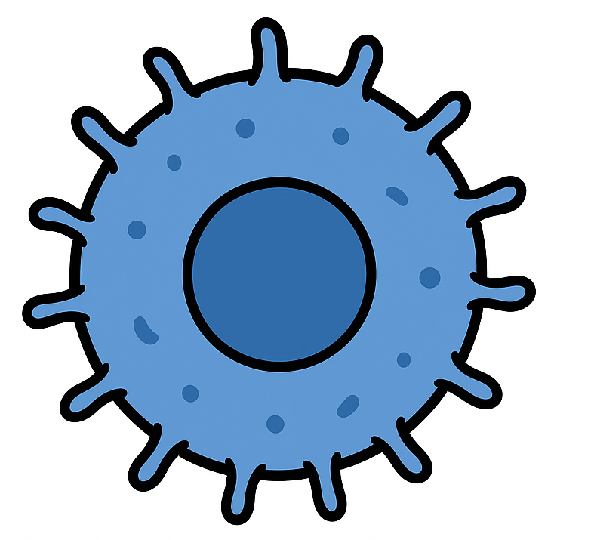
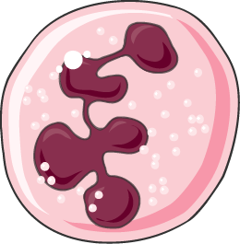
Radial Colocalization Methodology
21-micron diameter
Weight = 1
Weight = 1
No Weight (Outside of interaction range)

Slide 3
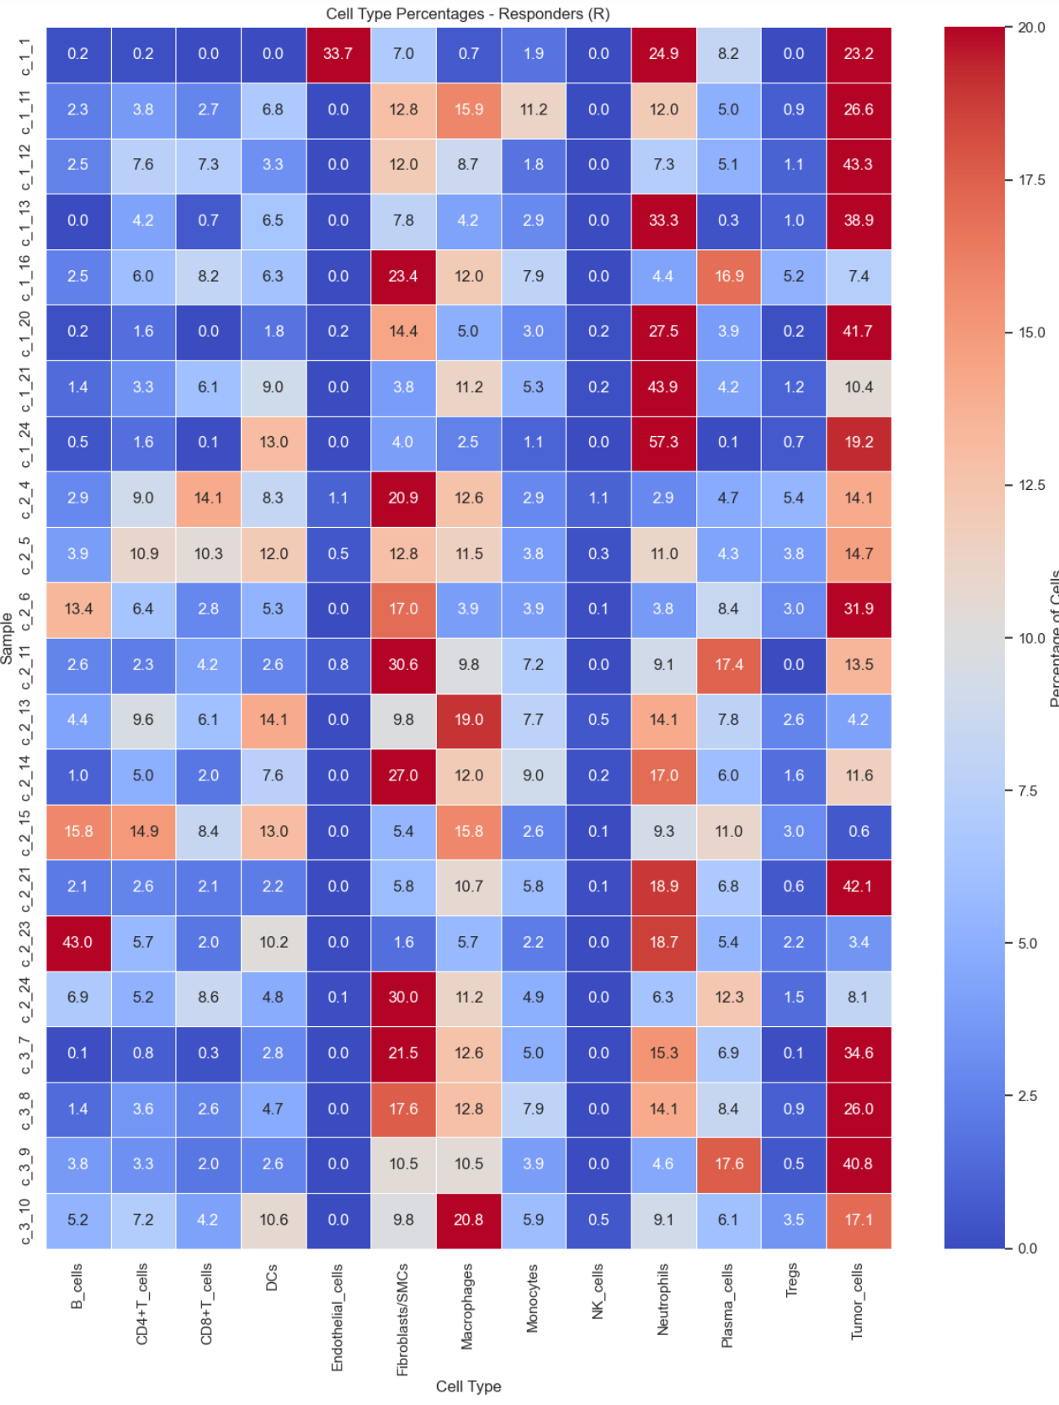
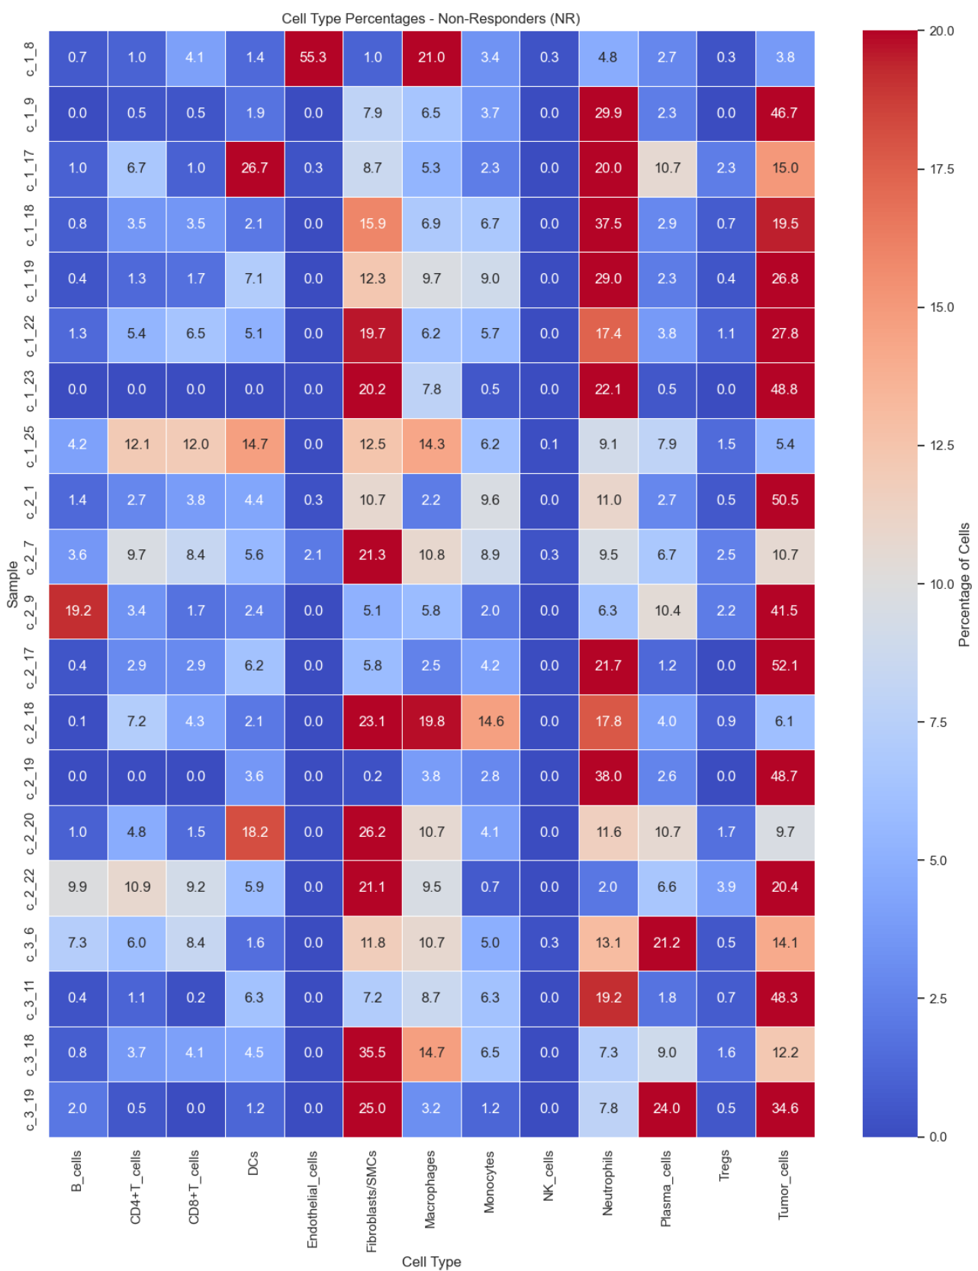
21 Micron PMN-Cell Type Notable Findings
Responder
Non-Responder
In non-responder groups
More neutrophil clustering
Marginally higher neutrophil-tumor iteractions
Overall variation not huge

Slide 4
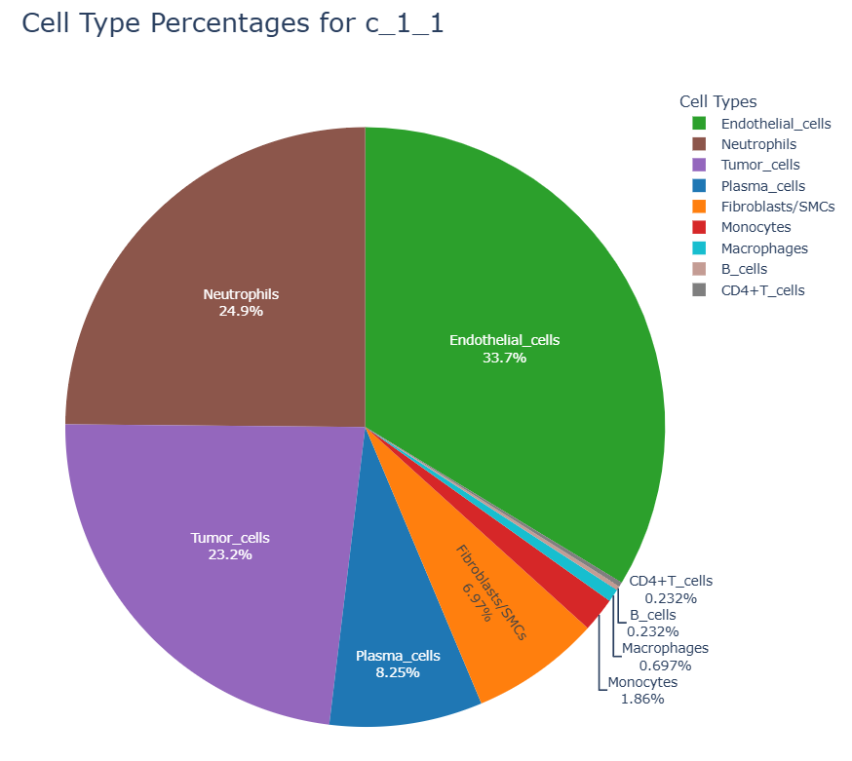
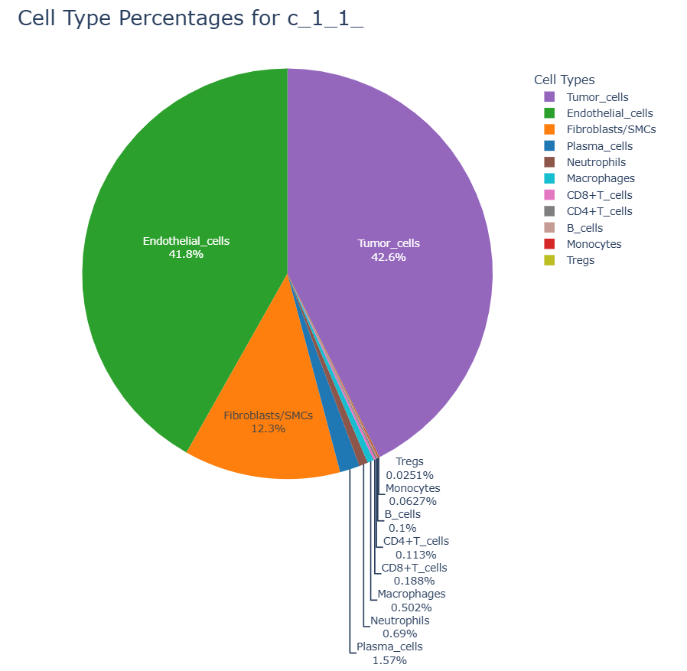
Delta Cell Interaction Percentages
Neighboring Cells
-
Overall Sample Frequency
=
Delta Matrix
PMN = 24.9 – 0.96 =24.16%
Tumor=-19.4%
Endo= - 8.1%
Etc…..

Slide 5
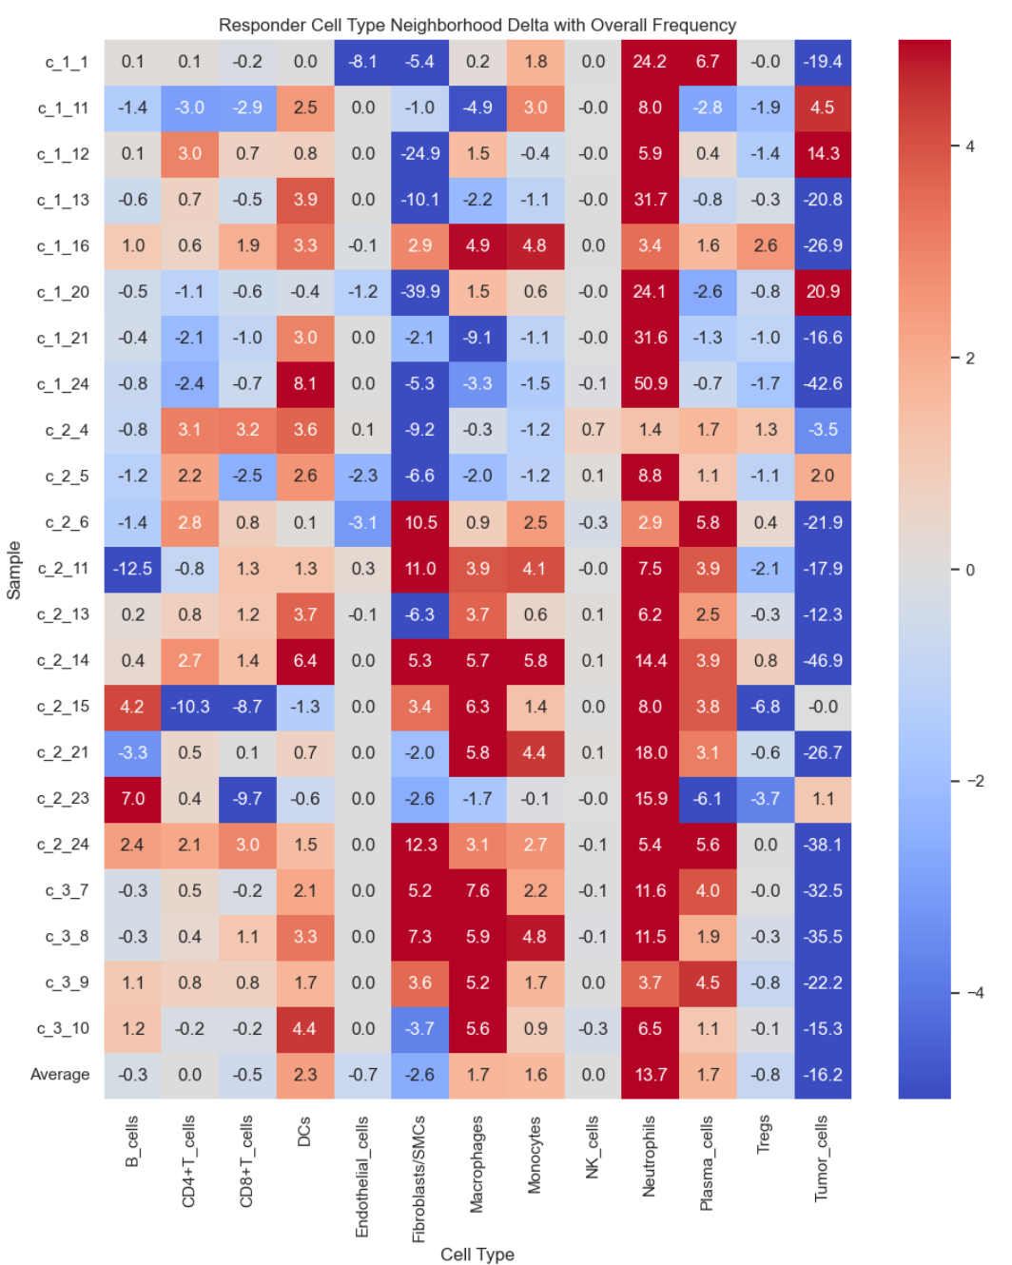
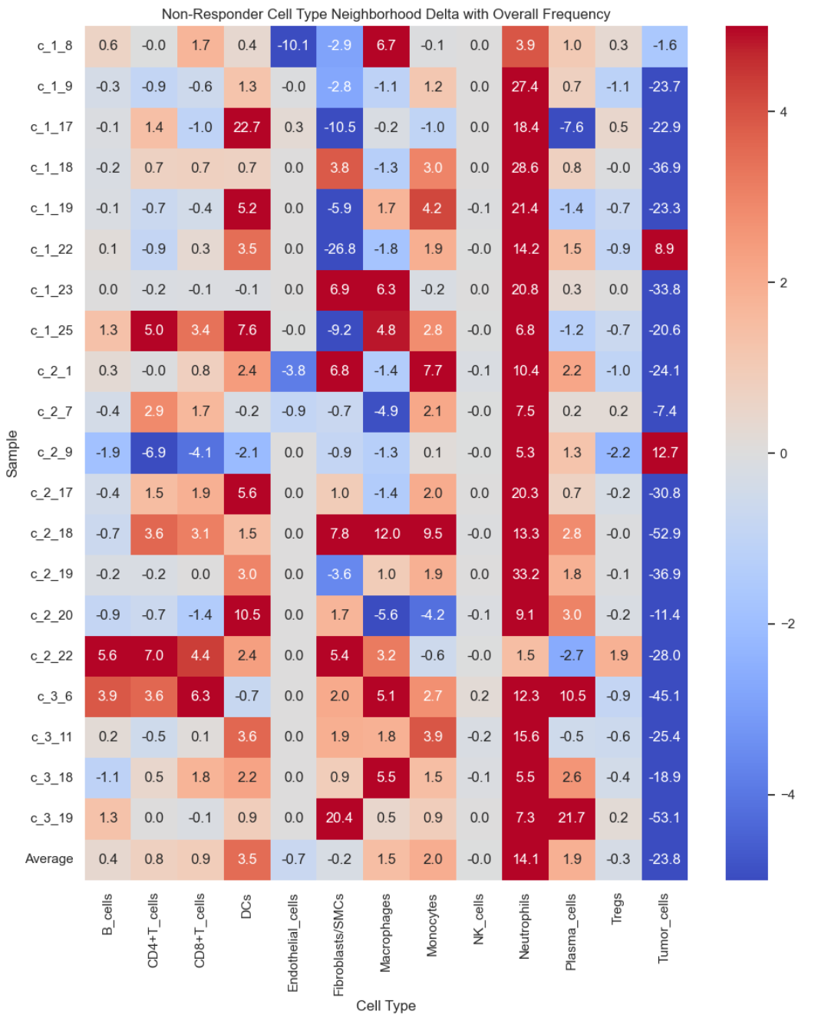
Delta Matrix compared to overall frequency
Responder
Non-Responder
Compared to overall cellular frequency responders were more likely to be near tumor cells than non-responders.
CD8 and CD4 numbers are similar. Correcting for overall cell numbers removes the closer association found in the neighborhood analysis in week 4.

Slide 6
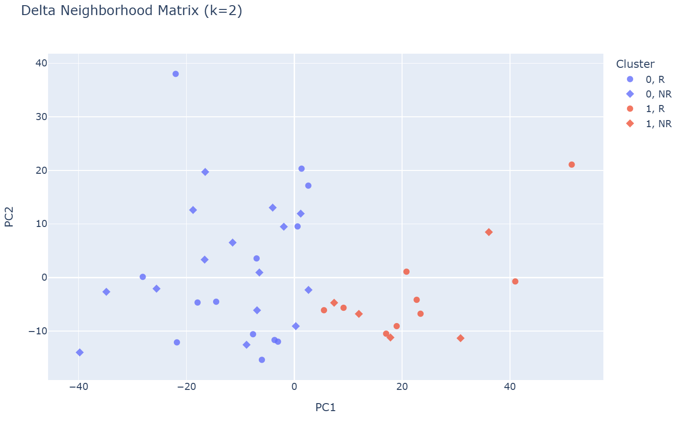
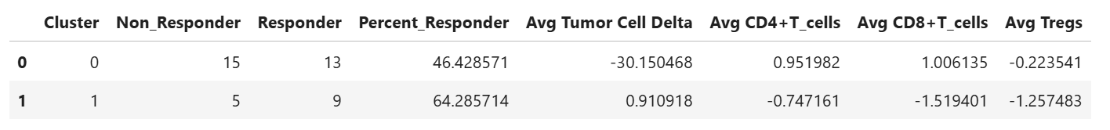
K Means Clustering – Delta Neighborhood
In the delta neighborhood k means clustering PC1 appear linked to tumor co-localization.
Cluster 1 patients with higher PMN colocalization had better response rates than those who did not. (64% vs 46%).
They were located closer to tumor cells and farther from immune cells

Slide 7
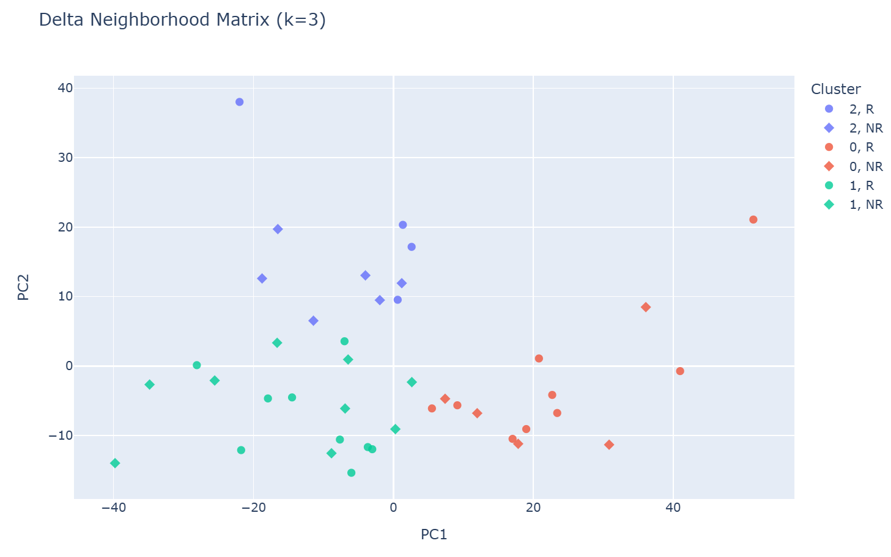
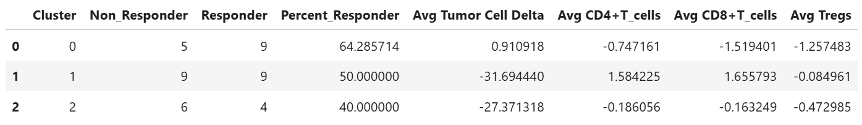
K Means Clustering – Delta Neighborhood
In the delta neighborhood k means clustering PC1 appear linked to tumor co-localization.
Cluster 0 patients with higher PMN colocalization had better response rates than those who did not.

Slide 8

Distance Calculations Methodology
Finds the distance between all PMNs and specified other cell types (CD4, CD8, Treg, Tumor)
Calculates closest cell of that type
Calculates the average distance to all cells of that type
Tumor Cells
Closest Tumor Cell
CD8+ T-Cells
Closest CD8 T-Cell

Slide 9
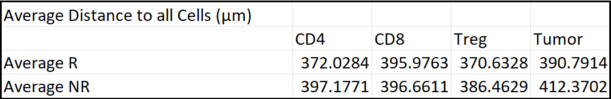
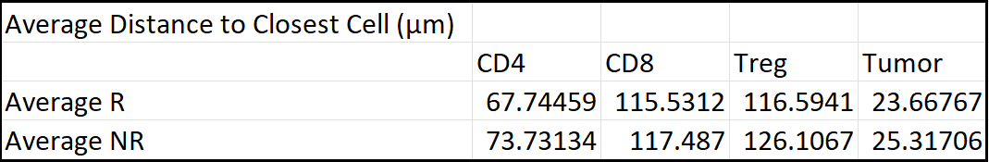
PMN Distance to Immune and tumor cells
No large differences in general. There are a lot of confounding factors.
Confounding factors
Quantity of cell types
Distribution of cells
Future Directions: weighted average interaction matrix

Slide 10
Weighted Average Interaction Matrix
Current
Proposed
Weight = 1
High Weight (2.5)
Weight = 1
Lower Weight (0.6)
No Weight (Outside of interaction range)
No Weight (Outside of interaction range)

Slide 11
Further Directions
Look for tumor-PMN interactions on genes found in Lit review
mRNA: STAT3, IL10, PDCD1, CD274, PDCD1LG2
Protein: PD1, PDL1
Question: Could expression of these genes along the border predict response status?
Distance weighted function for colocalization
Cells within ~30 um get some weight. So, a cell 5 um away gets more weight than a cell ~30 um away instead. Currently all cells within radius/top 6 have equal weight.
Subdivide and compare within samples (grids mentioned last week)
Mapping protein to mRNA.
Will only be feasible for some samples.

